Slide 1
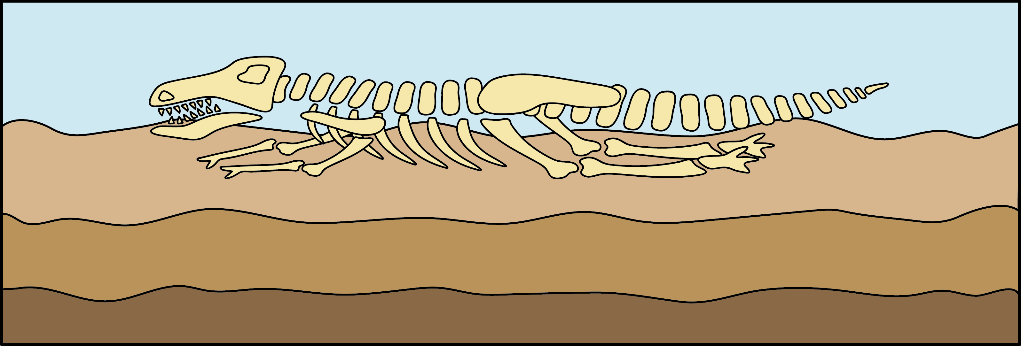
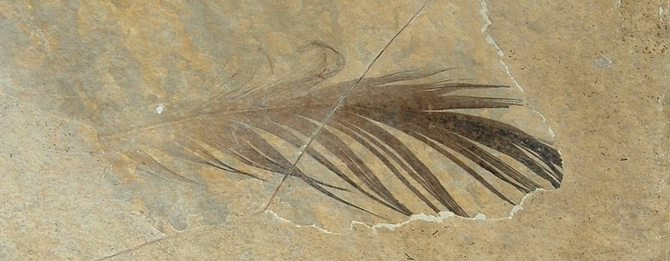
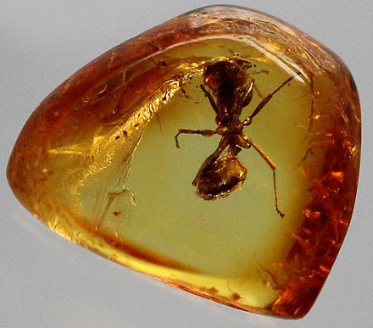
Rocks
Types of rocks
Soil
The Earth’s crust is made from rocks and minerals.
There are three types of natural rocks: sedimentary, igneous and metamorphic.
Concrete and bricks are not natural rocks. They are man-made and are called anthropic rocks.
Some rocks are permeable (let water and other substances through), and others are impermeable.
Soil is a mixture of tiny pieces of rock, dead plants and animals, air and water.
Formation of natural rocks
Igneous rocks are formed when magma and lava (melted rock) cool and harden. They are hard and impermeable.
Sedimentary rocks are formed when rocks are broken up and then deposited in layers. They are soft and permeable.
Metamorphic rocks are formed when sedimentary and igneous rocks are under large amounts of pressure and heat.
Fossils
Fossils are the preserved remains or traces of dead organisms.
Fossils provide evidence of extinct species.
Some of these extinct species are classed as megafauna.
Megafauna are large animals.
Some fossils are preserved remains that have turned to rock.
Trace fossils are the preserved remains of other evidence of life, like fossilised poo or feathers.
The remains of some organisms are preserved in ice or amber.
Oligocene feather by paleobear, CC BY 2.0, via Flickr
Fossil ant by Manukyan Andranik, CC BY-SA 4.0, via Wikimedia Commons
Chemistry | Year 3 – Autumn 1 | Knowledge Organiser
Notes:
Fossil diagram – United Learning
Fossil ant (CC BY-SA 4.0) – https://commons.wikimedia.org/wiki/File:Fossil_ant_(Hymenoptera,_Formicidae)_in_Baltic_amber._Age_50_Mill._years_(the_Lower_Eocene).JPG
Fossil feather (CC BY 2.0) – https://www.flickr.com/photos/paleo_bear/7991972138/

