Slide 1
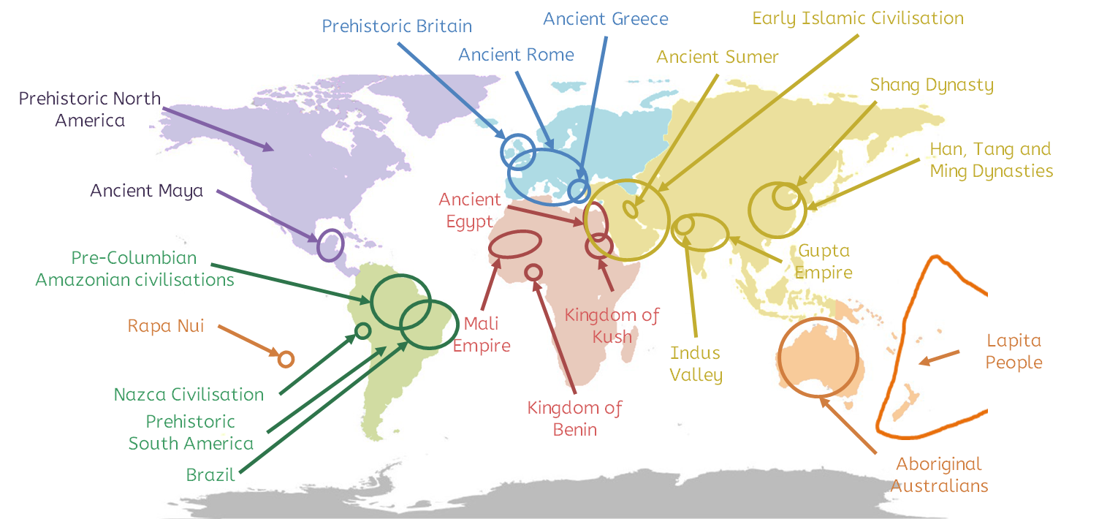
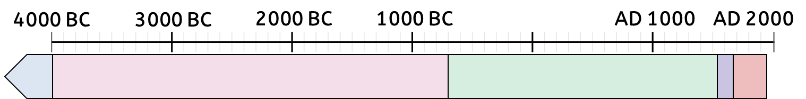
Quest for Knowledge
1
2
3
4
5
The first homo sapiens (humans that we are) lived in Africa 200 000 years ago. Groups of humans started to migrate slowly across the world. Before writing, people remembered and shared knowledge by speaking it. This is called the oral tradition.
The earliest civilisations had many similarities. Many made developments in mathematics, engineering, medicine, astronomy and writing…
Before the modern world, civilisations had many similarities. For example…
Copernicus wrote about the heliocentric model in 1543. After this: People started to ask new questions about the natural world. Scientists developed the scientific method, similar to what we use today. Discoveries that were new in Europe, like gravity and forces, were made. A new standard for knowledge was set. Scientists required each other to prove knowledge with evidence and have their work checked.
Europeans believed their new knowledge was superior to that of indigenous peoples. Europeans tried to impose knowledge like medicine, languages and beliefs. They exploited indigenous knowledge.
1
Teachers should adapt this based on the themes and civilisations they have focused on.
2
3
4
5
History | Year 5 – Summer Term | Knowledge Organiser

