Slide 1


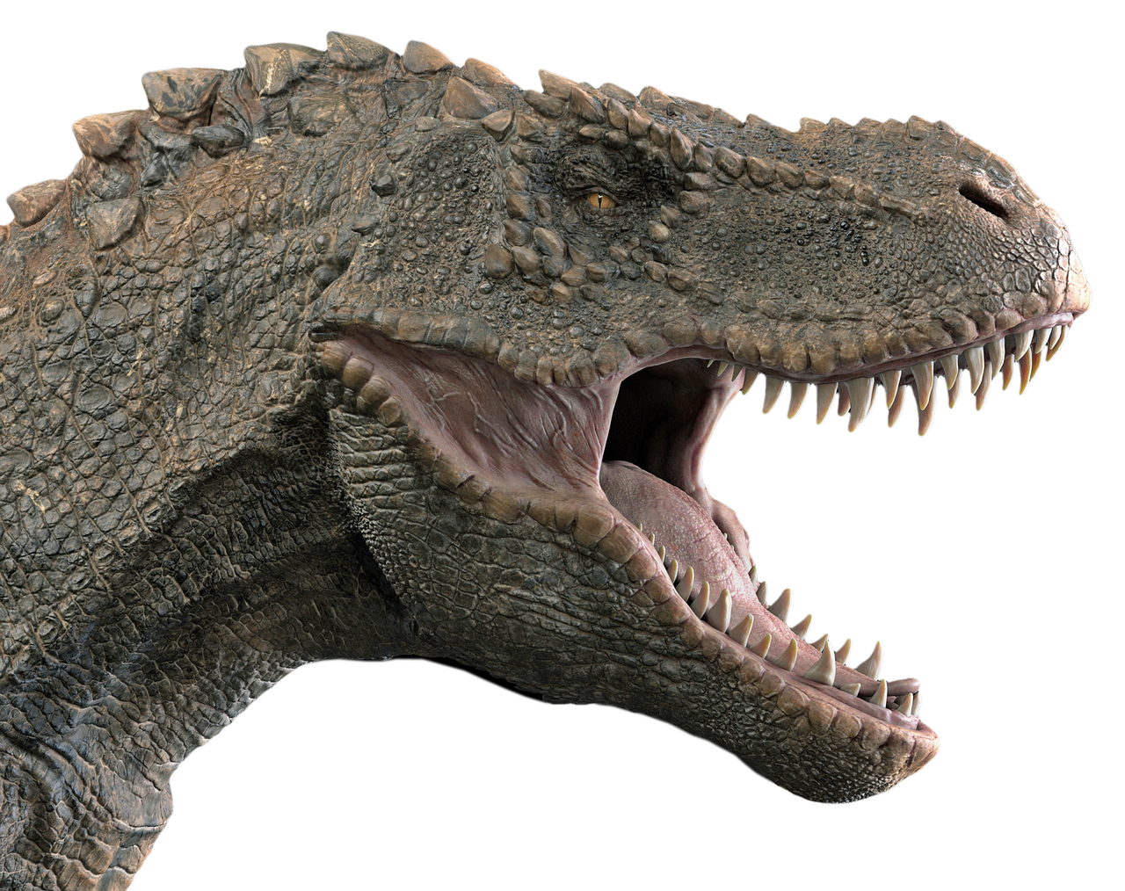
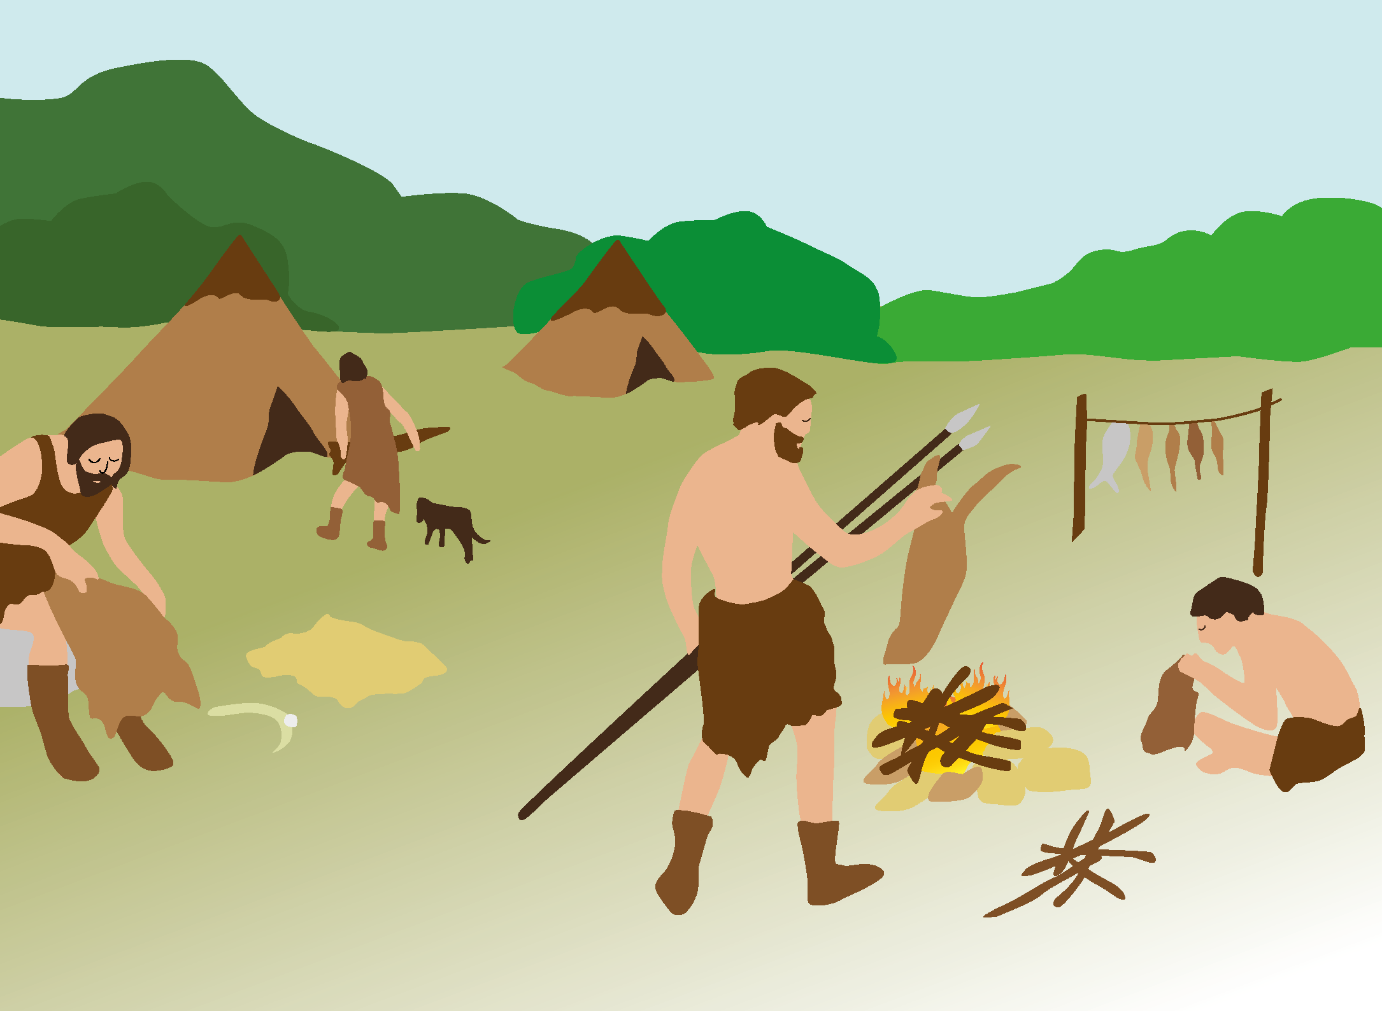
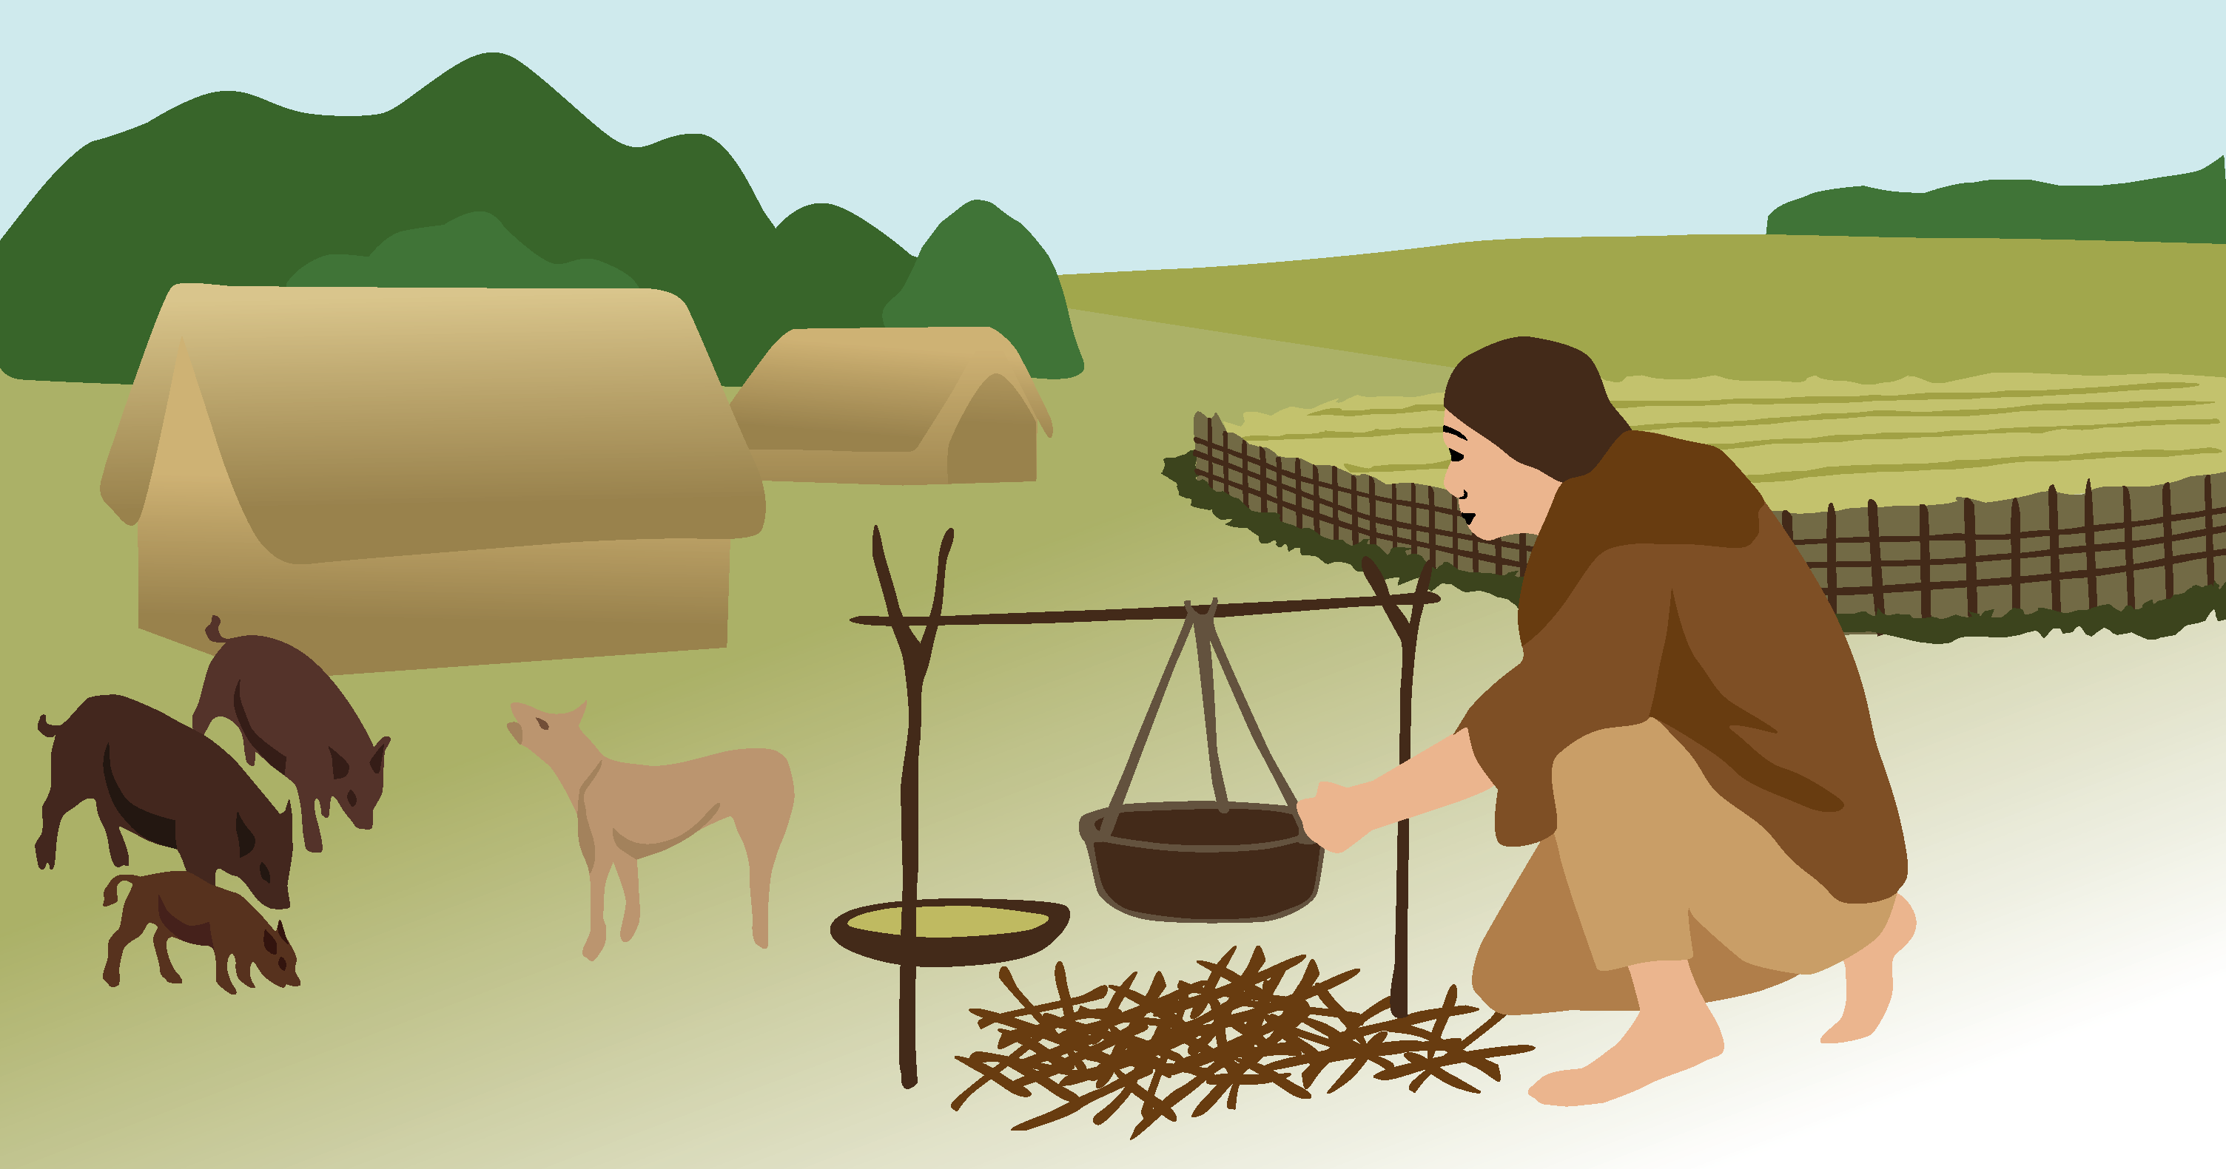
Prehistoric Britain
There is a simplified version of this Knowledge Organiser on Slide 2.
The Big Picture
Prehistoric Britain
Today
Britain became an island.
Earth was formed.
The first homo sapiens lived.
The first Neanderthals lived.
Ice Age began.
The Earth was formed billions of years ago. The dinosaurs lived a very long time ago but died out before any human animals – like Neanderthals or homo sapiens like us – walked the Earth.
Changes from Stone Age to Iron Age
Stone Age
Bronze Age
Iron Age
Palaeolithic
Mesolithic
Neolithic
Hunter-gatherers hunted animals and gathered fruits and nuts. | → | People started to farm the land and keep animals for food.
Communities were smaller. | → | Communities were larger.
Settlements were temporary and people lived a nomadic lifestyle, moving in search of food to hunt and gather. | → | Settlements were more permanent, centred around farm land.
Many prehistoric Britons held spiritual beliefs about the natural world and built stone circles and hill forts that lined up with the Sun’s movements.
History | Year 3 – Autumn | Knowledge Organiser

Slide 2
Prehistoric Britain
Britain became an island.
Today
The first homo sapiens lived.
The first Neanderthals lived.
Ice Age began.
Dinosaurs lived.
Earth was formed.
Changes from Stone Age to Iron Age
Stone Age
Bronze Age
Iron Age
Palaeolithic
Mesolithic
Neolithic
People hunted animals and gathered fruits and nuts. | → | People started to farm.
Communities were smaller. | → | Communities were larger.
People moved around often in search of food to hunt and gather. | → | People stayed in one place for longer.
History | Year 3 – Autumn | Knowledge Organiser

