Slide 1
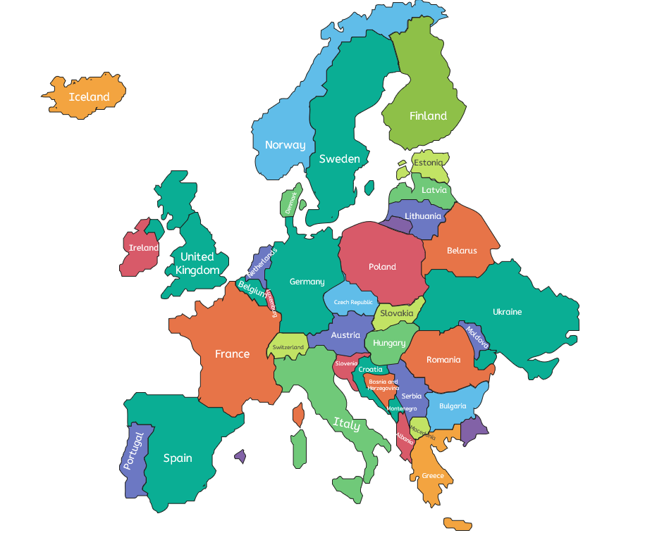





Looking at Europe
Europe
3 Regions in Europe
Europe is the continent we live on.
It is split into lots of different countries.
Part of the country of Russia is in Europe, and part of it is in Asia.
The Peak District (UK) – This is an area of hills in the counties of Derbyshire, Cheshire, Staffordshire, Yorkshire and Greater Manchester, located in north-central England.
Graian Region (The Alps) – The Alps is a large mountain range in Europe, which stretches across lots of countries. The Graian Region is a region within the Alps. It is spread across parts of France, Italy and Switzerland.
Amalfi Coast (Italy) – This is a coastal region along the southwest of Italy. It has many beaches and some mountains inland.
or the school’s local area!
Tourism
Social, economic and environmental impacts
A tourist is someone who visits a place for leisure (for fun!). Whenever we go on holiday – inside or outside of the UK – we are tourists.
Tourism is the business of encouraging tourists to come to a place and helping them enjoy themselves when they arrive.
Social
Economic
Environmental
An impact on the lives of people.
An impact that relates to money in the area.
An impact on the local environment.
Tourism can have social, economic and environmental impacts on an area. For example:
Tourists may not always behave and they might upset the local population.
Local traditions keep going and can be shared with tourists from across the world.
Tourism creates jobs in an area, such as with restaurants, tour companies and activity centres.
The costs of homes or activities in the area may rise, becoming too expensive for local people.
Tourists may bring extra traffic and pollution, and they may drop litter.
Wildlife and the environment may be damaged by the activities of tourists.
Geography | Year 3 – Summer Term | Knowledge Organiser
Notes:
All images – United Learning

