Slide 1
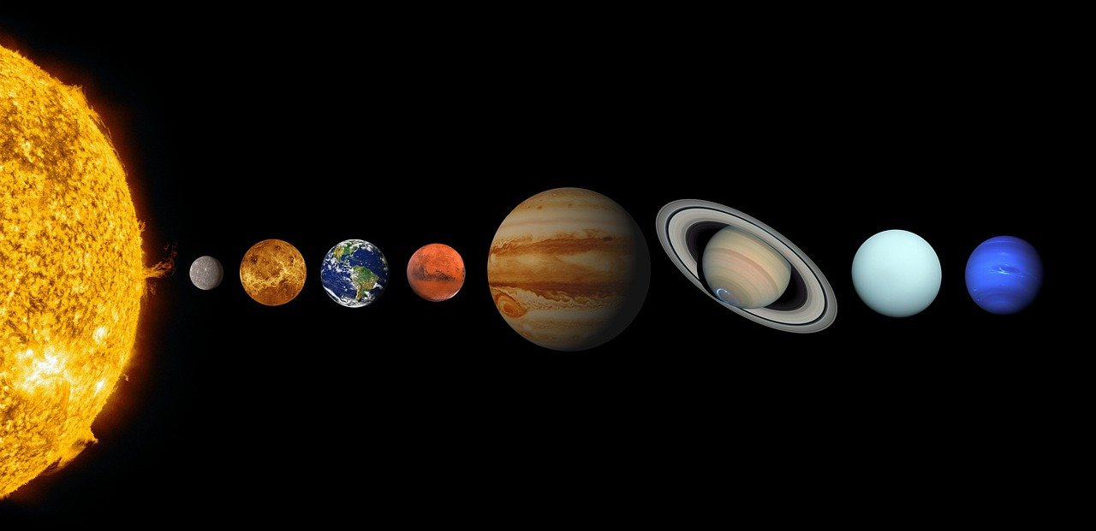
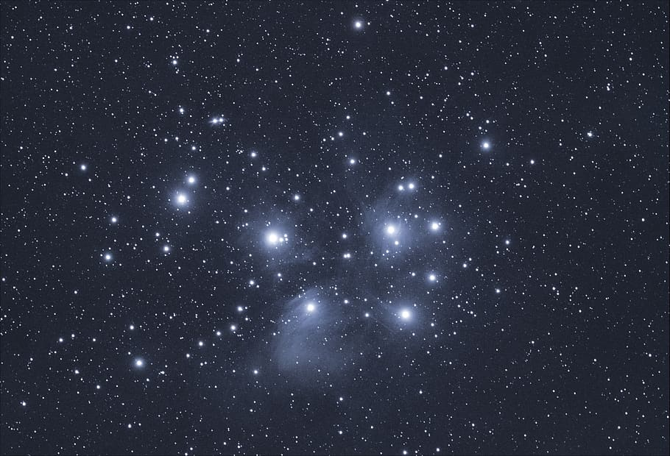
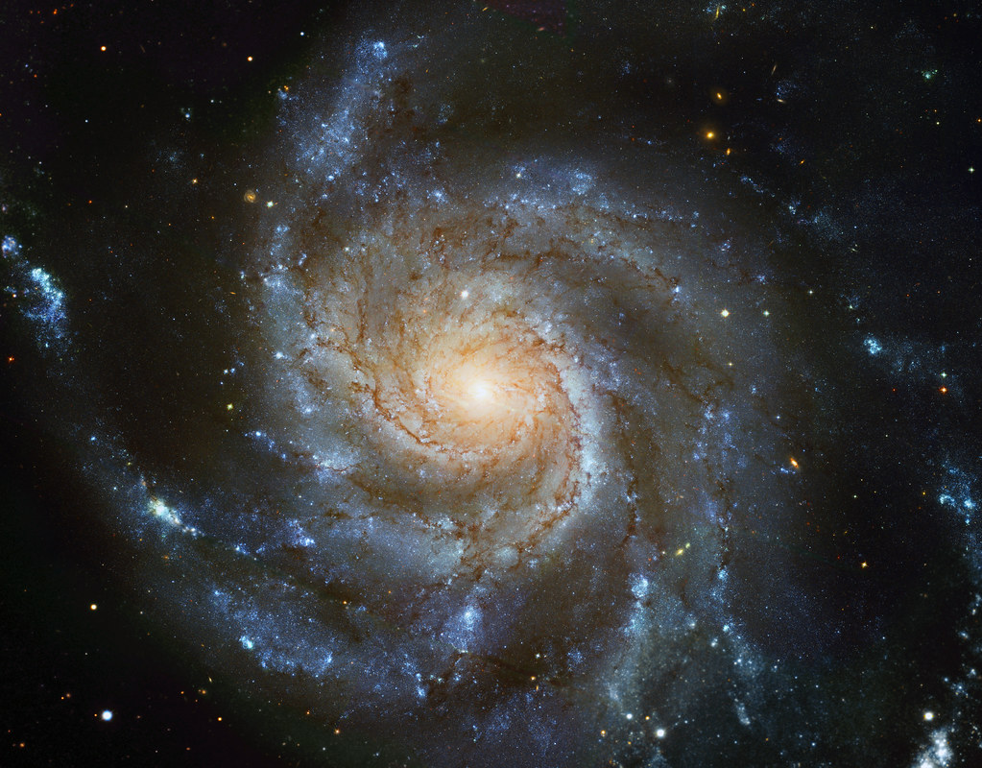
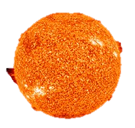
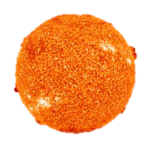
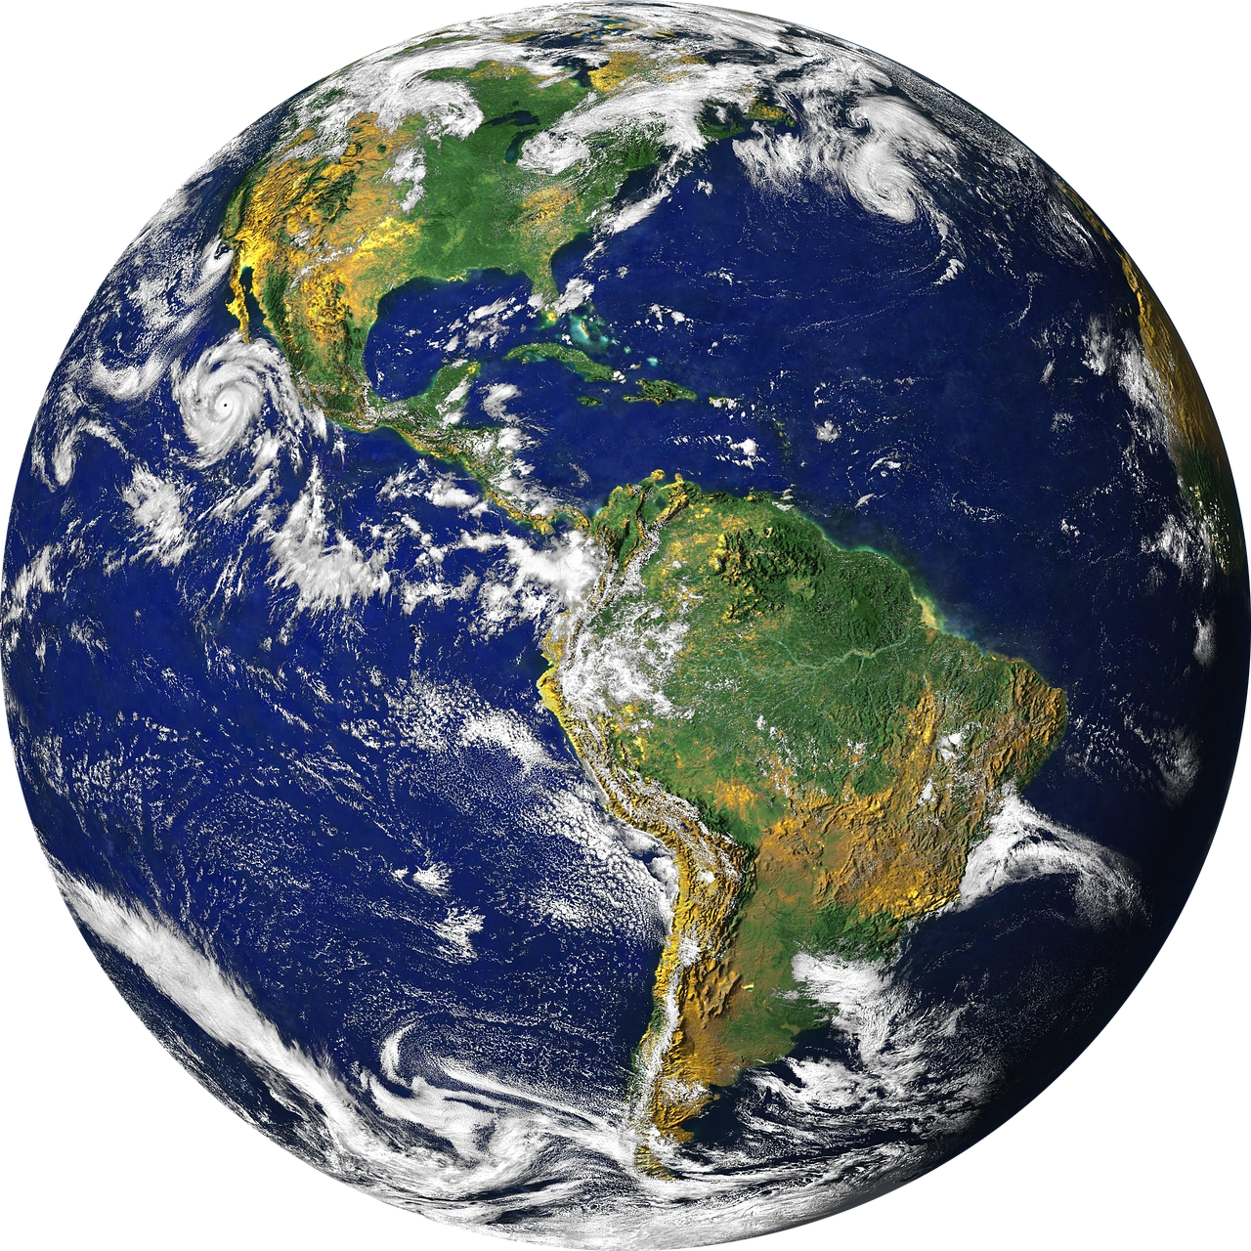
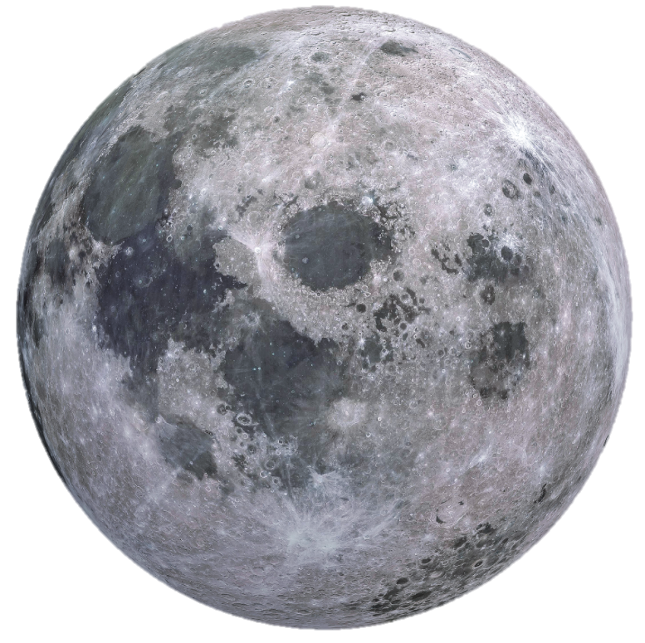
Earth & Space
Diagrams are not to scale
The universe and our solar system
Jupiter
Uranus
Mercury
Earth
Venus
Mars
Saturn
Neptune
The universe is made of many galaxies.
The galaxy we live in is called the Milky Way. It contains our solar system.
Our solar system contains a star (the Sun) and eight planets (including Earth).
Orbits
Rotations
Sun
Light from the Sun travels in straight lines, so only one half of the Earth can be in daylight at one time.
The Earth rotates on its axis (spins) once every 24 hours. This means we have 12-hour days and 12-hour nights.
light
axis
Moon
Earth
The Sun is at the centre of our solar system. This is known as the heliocentric model.
The Earth orbits the Sun. It takes 365 ¼ days to do this.
The Moon orbits the Earth. It takes 28 days to do this.
Time Zones
The Earth has 24 different time zones, split by imaginary lines called meridians. Each zone is a number of hours ahead or behind time in London.
‘Spiral galaxy’ (CC BY-SA 4.0) by ESA/Hubble
Physics | Year 5 – Summer Term | Knowledge Organiser
Notes:
Universe (CC0) - https://www.pxfuel.com/en/free-photo-xnsho
Galaxy (CC BY-SA 4.0) - https://en.wikipedia.org/wiki/File:M101_hires_STScI-PRC2006-10a.jpg
Solar System (CC0) - https://cdn.pixabay.com/photo/2020/10/23/22/53/solar-system-5680167_1280.jp
Sun (CC0) - https://pixabay.com/nl/photos/zon-zonnevlam-de-ruimte-ruimte-11582/
Moon (CC0) - https://cdn.pixabay.com/photo/2016/04/02/19/40/moon-1303512_1280.png
Earth (CC0) - https://cdn.pixabay.com/photo/2016/04/24/04/53/globe-1348777_1280.png

