Slide 1
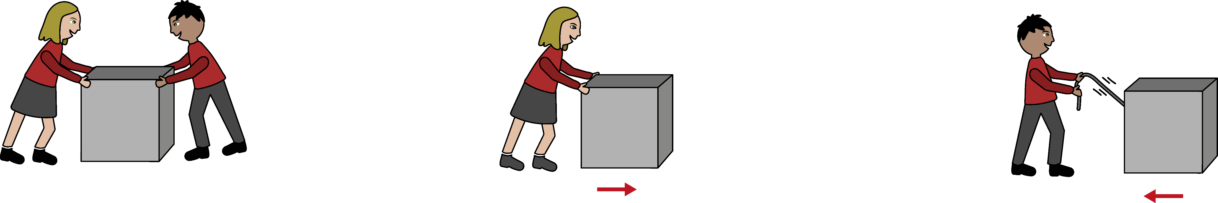
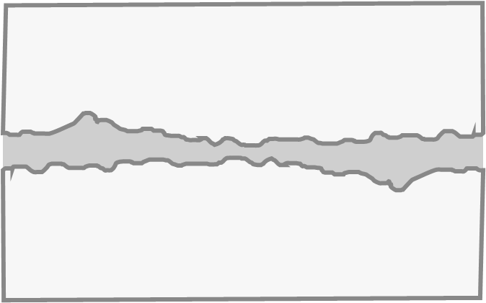
Forces and Motion
1
2
What is a force?
What can forces do?
A force is a push or a pull between two objects.
A force can:
Change the speed of an object (how fast/slow it moves).
Change the direction an object is moving in.
Change the shape of an object.
Pushes move objects away from you.
Pulls move objects towards you.
3
4
Using arrows to show forces
Balanced and unbalanced
We can use arrows to show the forces acting on an object.
Balanced forces are when opposing (opposite) forces are the same size.
Unbalanced forces are when opposing (opposite) forces are different sizes.
The length of the arrow can be changed to show bigger and smaller forces:
The direction of the force is shown by the arrowhead:
5
6
Forces and motion
Friction
Balanced forces do not cause a change in motion (speed or direction) or shape of an object. When forces are balanced:
  A stationary (still) object will stay still.
  A moving object will keep moving at a steady speed.
Unbalanced forces do cause a change in motion or shape of an object. When forces are unbalanced:
  A stationary object will start moving in the direction of the biggest force.
  A moving object will change its speed (speed up or slow down)..
Friction is a force that acts when two surfaces slide over each other.
It acts to slow the object down.
The rougher the surfaces, the greater the force of friction.
motion
friction
Physics | Year 3 – Summer Term | Knowledge Organiser
Notes:
Images – United Learning

